Slide 1
Project Scheduler Web App: Design
By: Jason Byrne

Slide 2
Overview
Reiterate Main Goal of Project
Database Design and Implementation
Demo Current State of Website
Updating Requirements
Schedule
Review

Slide 3
Main Goal
To create an web application that better manages the information and its organization for students taking CIS 598. The current application used is not the most efficient and could provide better usability and user experience.

Slide 4
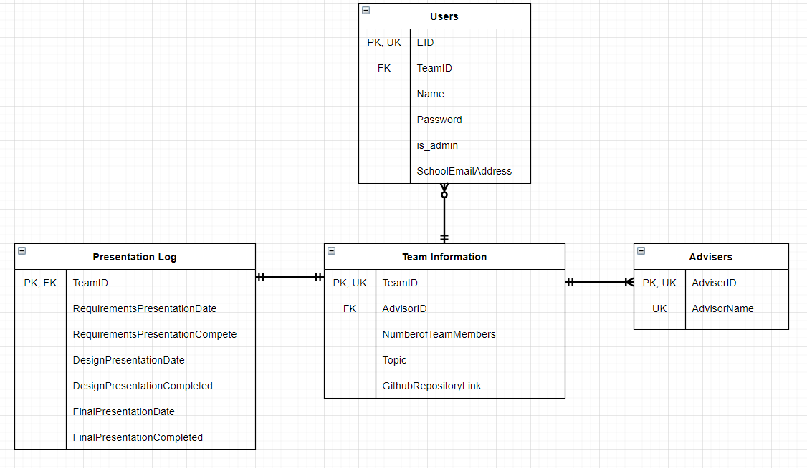
Database Design

Slide 5
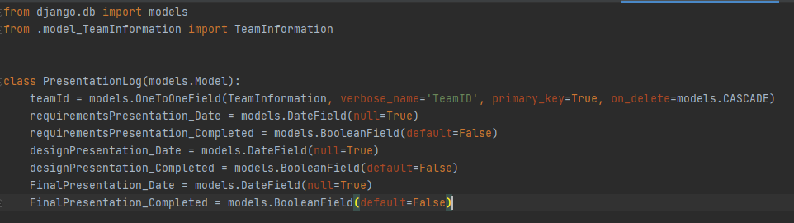
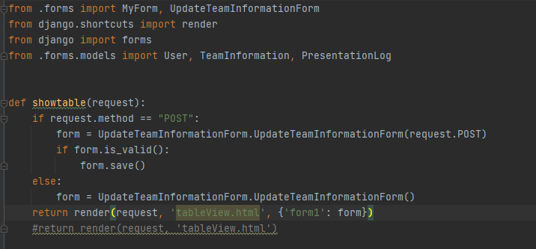
Database Implementation
models.py
views.py
Notes:
Just have the tables to hold information. For django the models are templates for the database tables and there is a directory for views that connect the website to the database

Slide 6
Base Website Demo
Website
Notes:
Website demo of its current state without data flow implemented yet

Slide 7
Updating Requirements
Initially Implement for Admin Use
Quality of Life Improvements: Dropdown List of Advisors, Date Picker for Presentations, Able to Mark Presentations as Complete, Easy to Add Students to Team, etc.
Stretch Goals:
User Registration for Students
Students can Request/Make Changes for Their Team’s Information

Slide 8
Schedule
January: Decide Topic and Choose Advisor
February: Research Tools and Start Project
March: Configure Database, Connect To Project,
April 5: Create Base Website
April 19: Implement Data Flow between Website and Database, Implement Updated Requirements
April 26: Final Website Aesthetic Adjustments
If Time Permits, Possibly Add Sign In Capability

Slide 9
Review
Reiterate Main Goal of Project
Database Design and Implementation
Demo Current State of Website
Updating Requirements
Schedule

Slide 10
Questions?

